Slide 1
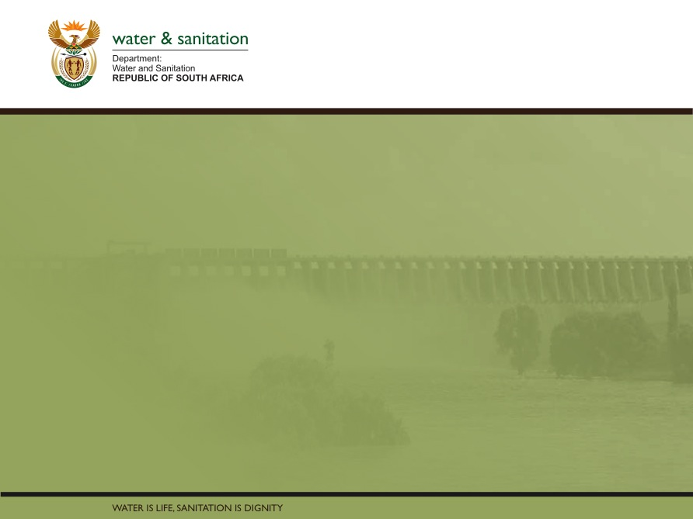
Classification, Reserve & RQO determination of water resources in the Mvoti to Umzimkulu Water Management Area
OVERVIEW OF CONSEQUENCES ON RIVERS
Delana Louw
Rivers for Africa
16 Sept 2015
PRESENTATION TITLE
Presented by:
Name Surname
Directorate
Date

Slide 2
Determining ecological consequences of scenarios
Need to answer the ‘what if’ questions
Express in terms of change in Ecological Category & degree to which the REC is met
Use the EcoClassification models to predict changes in all the biophysical components at each EWR site for each scenario.
Then integrate into the MC DSS process.
Only relevant for rivers with scenarios and EWR sites.

Slide 3
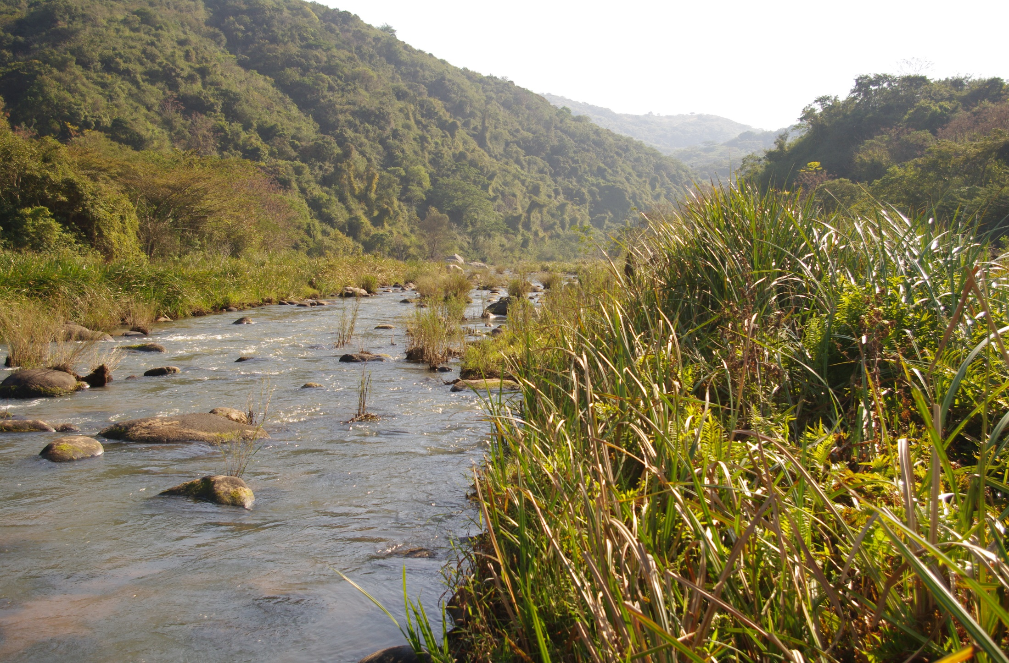
LOVU RIVER CONSEQUENCES
Range of scenarios evaluated that consists of different degrees of decreasing forestry and irrigation.
Main purpose is to see whether possible (and implications) of improving estuary

Slide 4
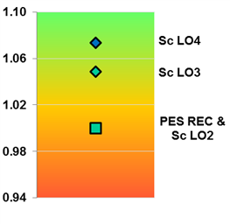
LOVU RIVER CONSEQUENCES

Slide 5
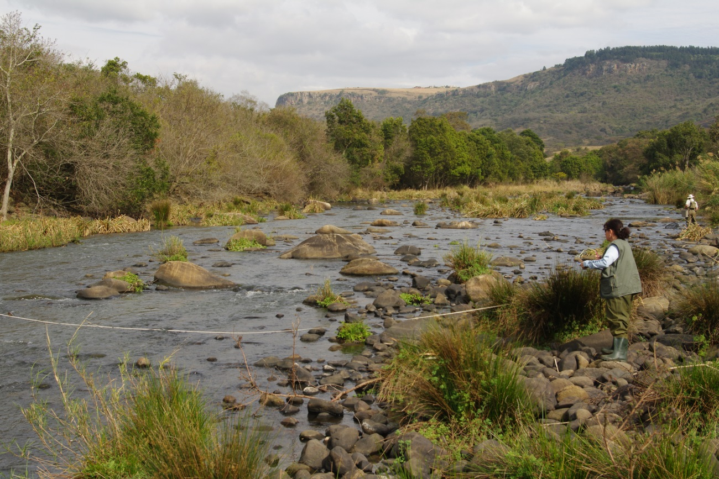
uMNGENI RIVER CONSEQUENCES
Range of scenarios evaluated that consists of different operating rules considering the current constraints and rules.

Slide 6
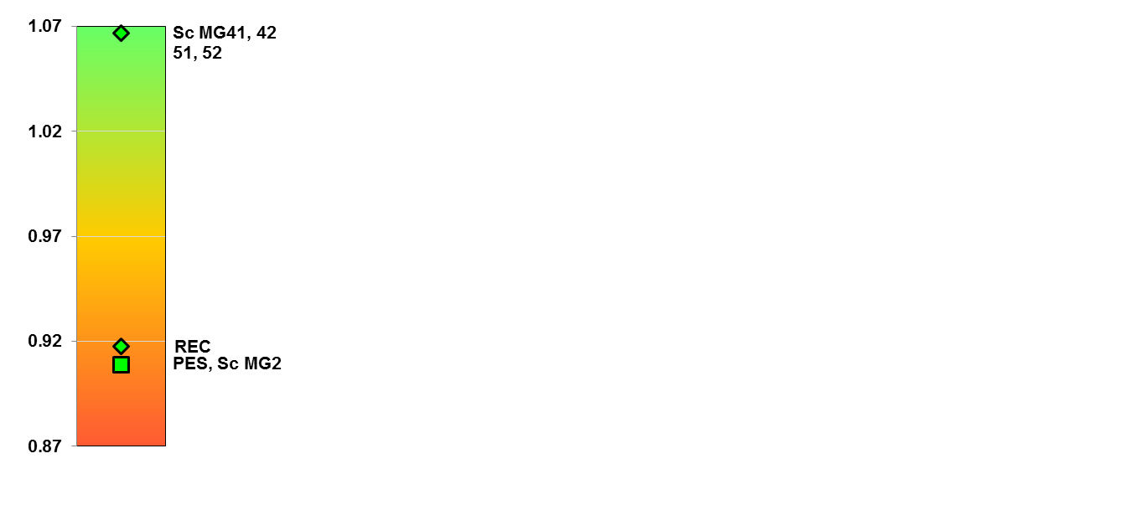
uMNGENI EWR 2 RIVER CONSEQUENCES

Slide 7
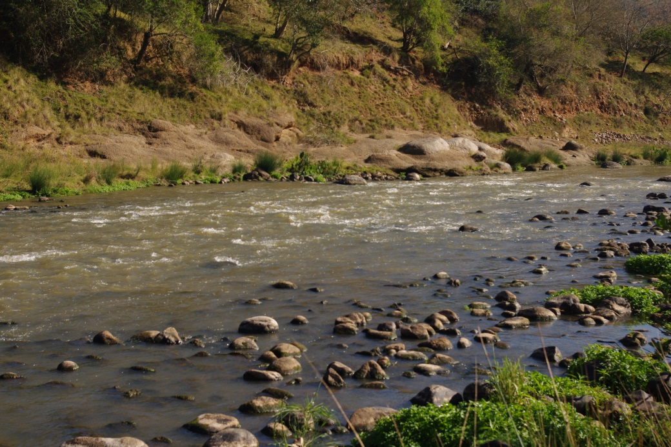
uMNGENI EWR 5 RIVER CONSEQUENCES

Slide 8
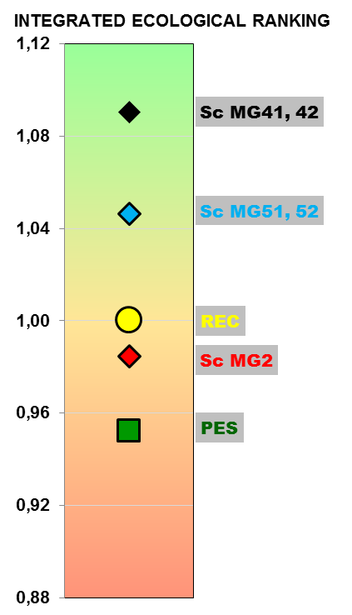
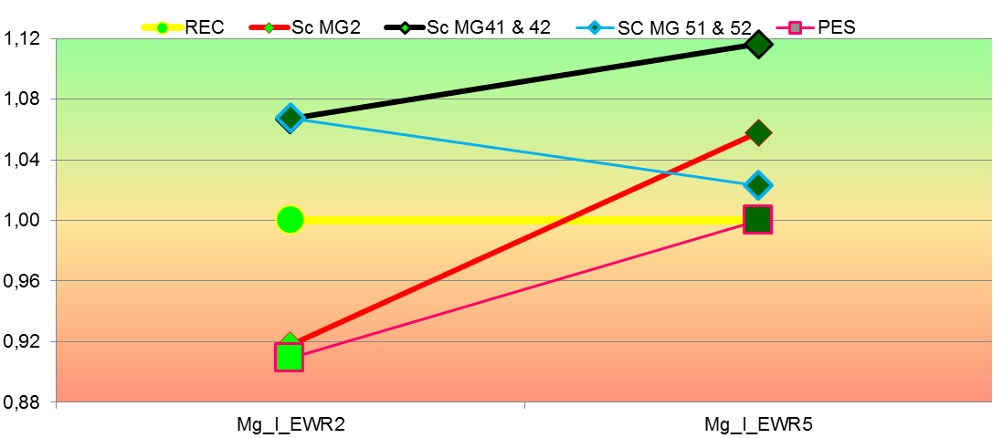
RANKED Umngeni SCENARIOS

Slide 9
CONCLUSION
All scenarios meet the REC except for scenario MG 2 on one uMngeni EWR site. The present state will however be maintained at this site. REC on uMngeni only requires improvement for fish – flow likely not the key issue.

Slide 10
  QUESTIONS FOR CLARIFICATION

